Slide 1


GP
Great Performance

Slide 2

Kirish va chiqish
01
Kirish va chiqishni avtomatlashtirish.

Slide 4
Mentor’s Attendance check
When we asked from mentors how much time do they spend on checking attendance, their answers were between 25-40 minutes
1 month of checking = 15-20 – hour of wasting

Slide 5
iFace Appplication working with face-recognition, voice-assistant, SPA

Slide 6
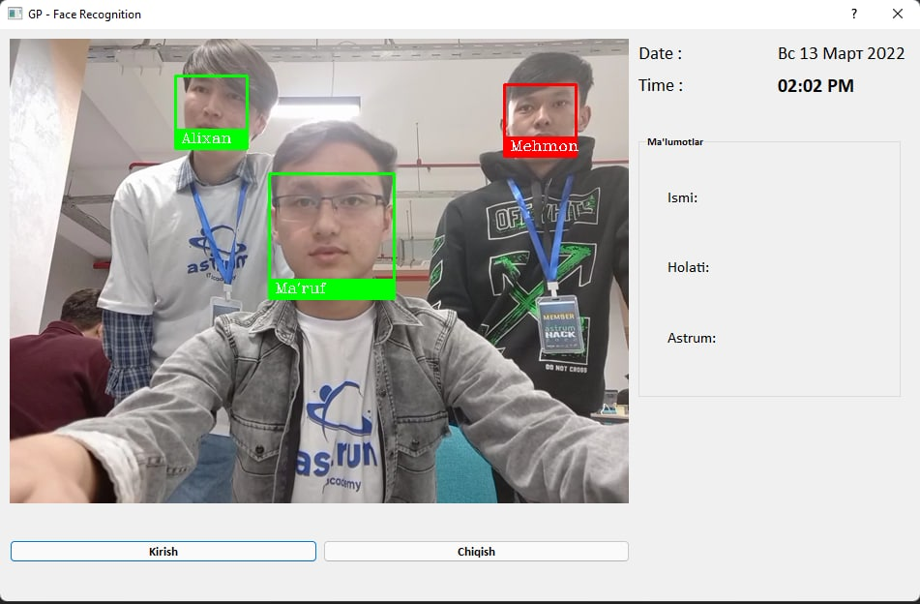

Slide 7
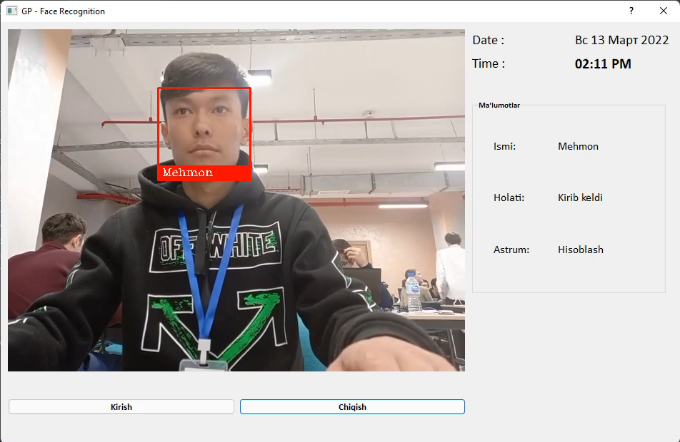
‘

Slide 8
Jarvis Voice Assistant
Uzbek speaking application for newcomers

Slide 9
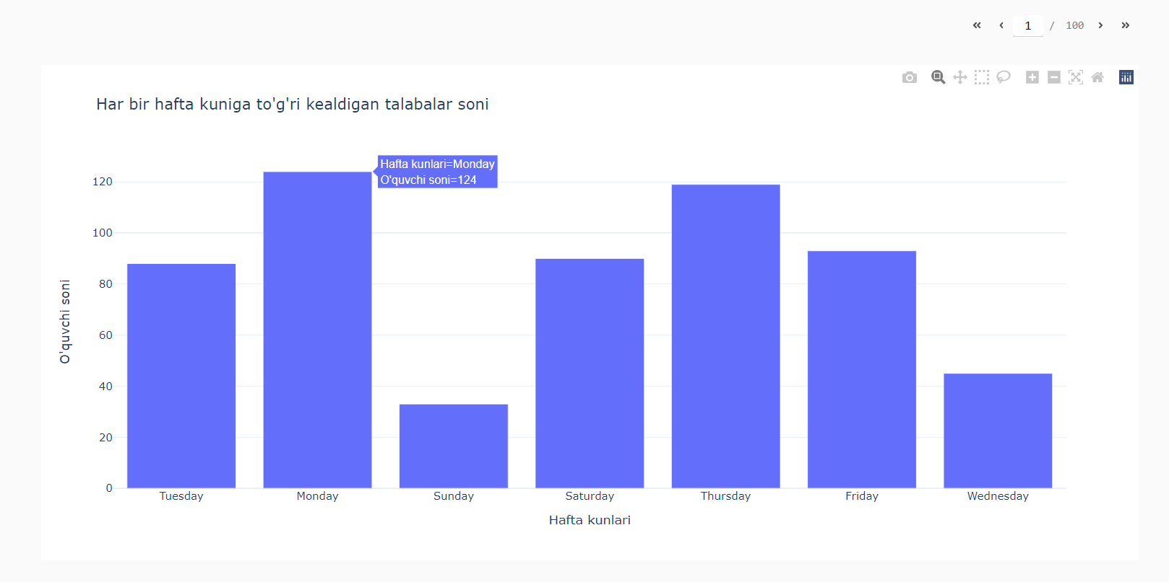
Check.it
1 - Talabani statusi
2 – Qaysi yo’nalish
3 – Talabalar kelganini statistikasi
4 – Astrum administratsiyasini optimal qabul qilishi uchun
5 – Kirish chiqishda inson mehnatini kamaytirish

Slide 10

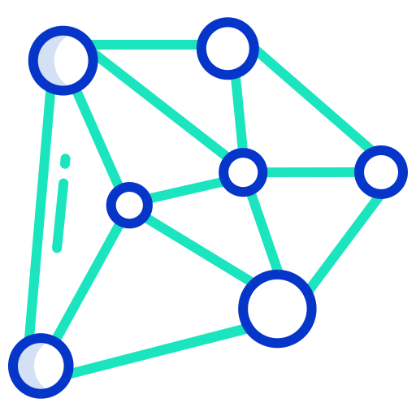
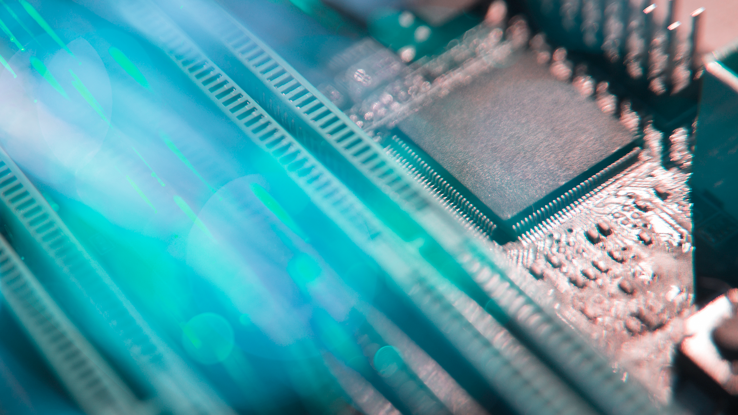
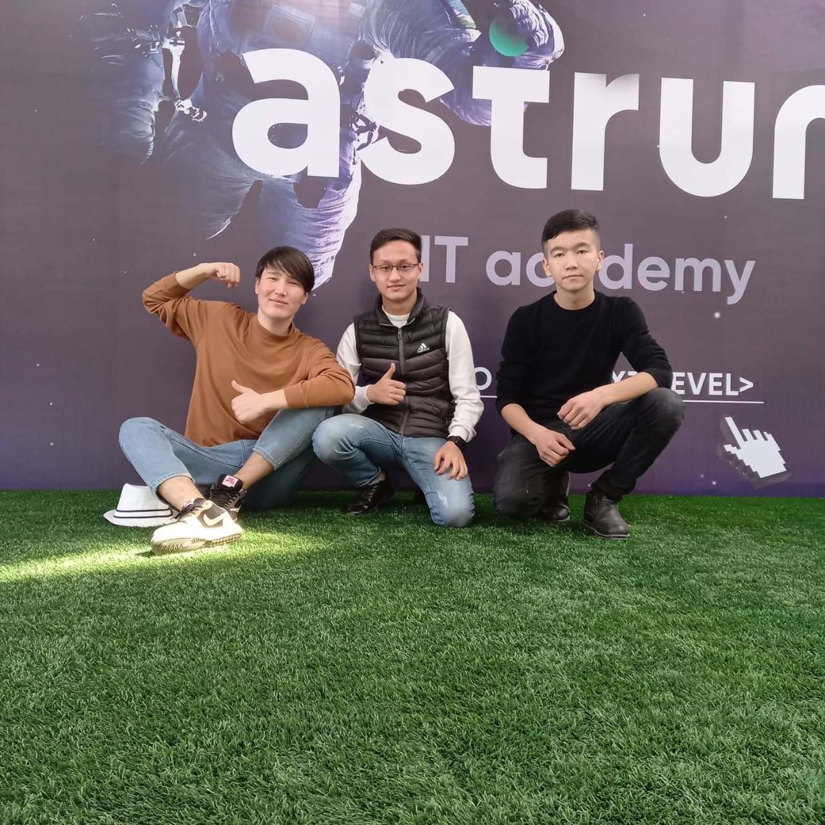
Great Performance
“The best way to predict the future is to build one.”

Slide 11
THANKS

